Slide 1
Autoencoder

Slide 2
Import Libraries
import tensorflow as tf
from tensorflow.keras import layers, models
import matplotlib.pyplot as plt
import numpy as np

Slide 3
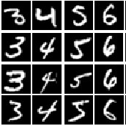
Load MNIST Dataset
Load the data
Normalize pixel values x = x / 255.0
Flatten images
x_train = x_train.reshape(-1, 784)
x_test = x_test.reshape(-1, 784)

Slide 4
Define Autoencoder Model
input_dim = 784
latent_dim = 32
# Encoder
encoder = models.Sequential([
layers.Input(shape=(input_dim,)),
layers.Dense(128, activation='relu'),
layers.Dense(latent_dim, activation='relu')
])
# Decoder
decoder = models.Sequential([
layers.Input(shape=(latent_dim,)),
layers.Dense(128, activation='relu'),
layers.Dense(input_dim, activation='sigmoid')
])
# Autoencoder
autoencoder = models.Sequential([encoder, decoder])

Slide 5
Compile Model & Train Model
Optimizer = Adam
Loss = MSE
batch_size=128
Plot Training Loss

Slide 6
Visualize Reconstruction
reconstructed = autoencoder.predict(x_test)
# Reshape for visualization
original = x_test.reshape(-1, 28, 28)
reconstructed = reconstructed.reshape(-1, 28, 28)
plt.figure(figsize=(8,4))
# Original
plt.subplot(1,2,1)
plt.imshow(original[0], cmap='gray')
plt.title("Original")
# Reconstructed
plt.subplot(1,2,2)
plt.imshow(reconstructed[0], cmap='gray')
plt.title("Reconstructed")
plt.show()

Slide 7
VAE

Slide 8
Import Libraries and Preprocess MNIST
import tensorflow as tf
from tensorflow.keras import layers, Model
import numpy as np
import matplotlib.pyplot as plt
(x_train, _), (x_test, _) = tf.keras.datasets.mnist.load_data()
x_train = x_train.astype("float32") / 255.0
x_test = x_test.astype("float32") / 255.0
x_train = x_train.reshape(-1, 784)
x_test = x_test.reshape(-1, 784)
input_dim = 784
latent_dim = 2 # keep 2 for visualization

Slide 9
Sampling Layer (Reparameterization Trick)
class Sampling(layers.Layer):
def call(self, inputs):
z_mean, z_log_var = inputs
epsilon = tf.random.normal(shape=tf.shape(z_mean))
return z_mean + tf.exp(0.5 * z_log_var) * epsilon

Slide 10
Build Encoder
# Encoder
encoder_inputs = layers.Input(shape=(input_dim,))
x = layers.Dense(128, activation="relu")(encoder_inputs)
z_mean = layers.Dense(latent_dim, name="z_mean")(x)
z_log_var = layers.Dense(latent_dim, name="z_log_var")(x)
z = Sampling()([z_mean, z_log_var])
encoder = Model(encoder_inputs, [z_mean, z_log_var, z], name="encoder")

Slide 11
VAE Model
# 🔹 Reconstruction Loss (Correct Version)
reconstruction_loss = tf.reduce_mean(
tf.keras.losses.binary_crossentropy(data, reconstruction)
) * input_dim
# 🔹 KL Divergence
kl_loss = -0.5 * tf.reduce_mean(
1 + z_log_var - tf.square(z_mean) - tf.exp(z_log_var)
)
total_loss = reconstruction_loss + kl_loss
grads = tape.gradient(total_loss, self.trainable_weights)
self.optimizer.apply_gradients(zip(grads, self.trainable_weights))
return {
"loss": total_loss,
"reconstruction_loss": reconstruction_loss,
"kl_loss": kl_loss }
class VAE(Model):
def __init__(self, encoder, decoder):
super(VAE, self).__init__()
self.encoder = encoder
self.decoder = decoder
def train_step(self, data):
if isinstance(data, tuple):
data = data[0]
with tf.GradientTape() as tape:
z_mean, z_log_var, z = self.encoder(data)
reconstruction = self.decoder(z)

Slide 12
Compile and Train
vae = VAE(encoder, decoder)
vae.compile(optimizer=tf.keras.optimizers.Adam())
vae.fit(x_train, epochs=10, batch_size=128)

Slide 13
Visualize Reconstruction
z_mean, z_log_var, z = encoder.predict(x_test[:10])
reconstructed = decoder.predict(z)
plt.figure(figsize=(10,4))
for i in range(5):
# Original
plt.subplot(2,5,i+1)
plt.imshow(x_test[i].reshape(28,28), cmap="gray")
plt.axis("off")
# Reconstructed
plt.subplot(2,5,i+6)
plt.imshow(reconstructed[i].reshape(28,28), cmap="gray")
plt.axis("off")
plt.show()

Slide 14
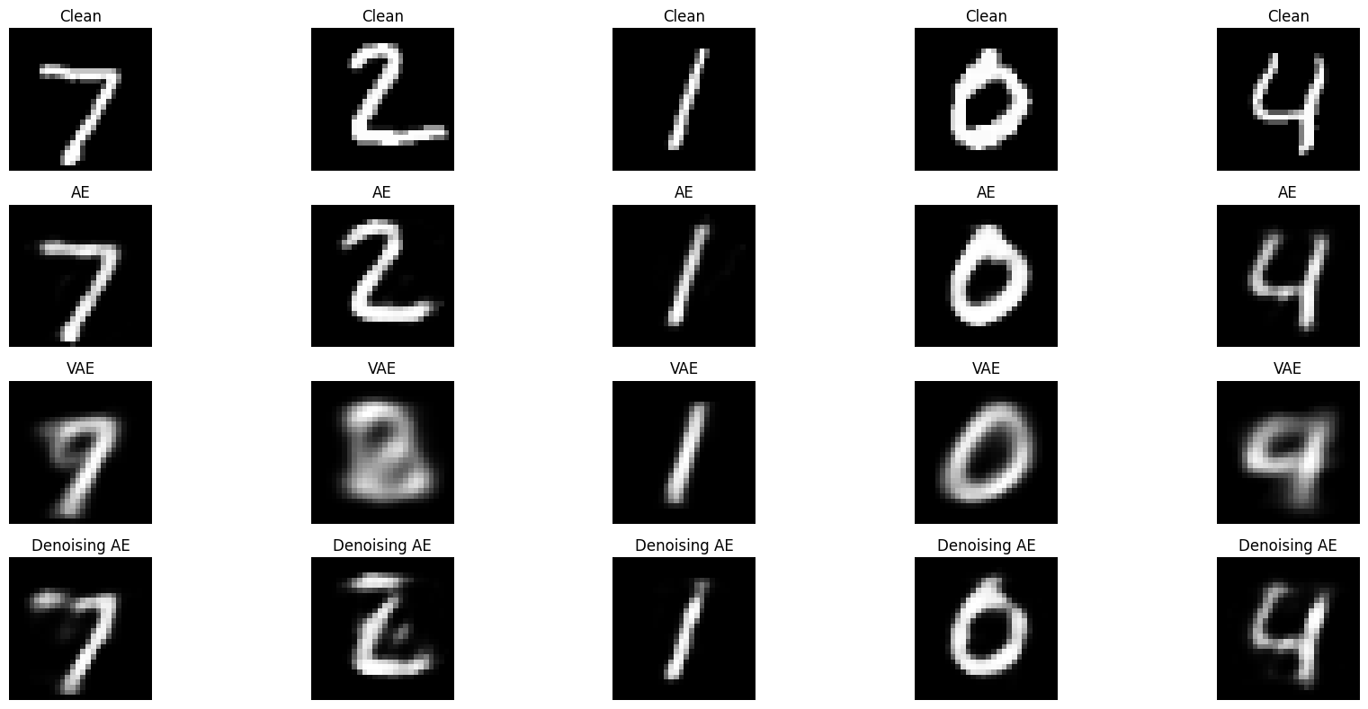
Lab Assignment
Denoising Autoencoder (Use the same dataset)
Add Gaussian noise:
noise_factor = 0.5
x_train_noisy = x_train + noise_factor * np.random.normal(size=x_train.shape)
x_test_noisy = x_test + noise_factor * np.random.normal(size=x_test.shape)
x_train_noisy = np.clip(x_train_noisy, 0., 1.)
x_test_noisy = np.clip(x_test_noisy, 0., 1.)
Train model:
Input = noisy image
Output = clean image
Compare:
Normal Autoencoder
VAE
Denoising Autoencoder
Show:
Clean image
VAE Reconstruct
AE Reconstruct
Denoising AE Reconstruct

